Slide 1

Account Intelligence Report: [Aviva Canada]
Prepared for [Evan Perkins] by the HP Account Intelligence Desk
This analysis reflects data from the past month and represents a point in time. Findings may shift as company priorities and market conditions evolve.
[
]
This information was pulled on [May 21, 2026.]

Slide 2


Executive Snapshot
Account name
Company overview
[Aviva Canada]
[Aviva Canada is a leading property and casualty insurer headquartered in Scarborough, Ontario. Founded in 1835, the company serves personal, SME, and large commercial clients across auto, home, business, cyber, fleet, surety bond, and travel insurance. Aviva Canada employs approximately 4,309 people and operates under CEO Nav Dhillon.]
Account type
[Private]
Industry
[Insurance – Property and Casualty]
Estimated annual IT budget
[$43.1M – $86.2M annually]
Installed technologies
[Microsoft Azure, Salesforce, Tableau, AWS, Java, Python, SQL Server, Oracle Database, Docker, Kubernetes, Jenkins, GitHub, Splunk, ServiceNow, Power BI, React, Node.js]

Slide 3
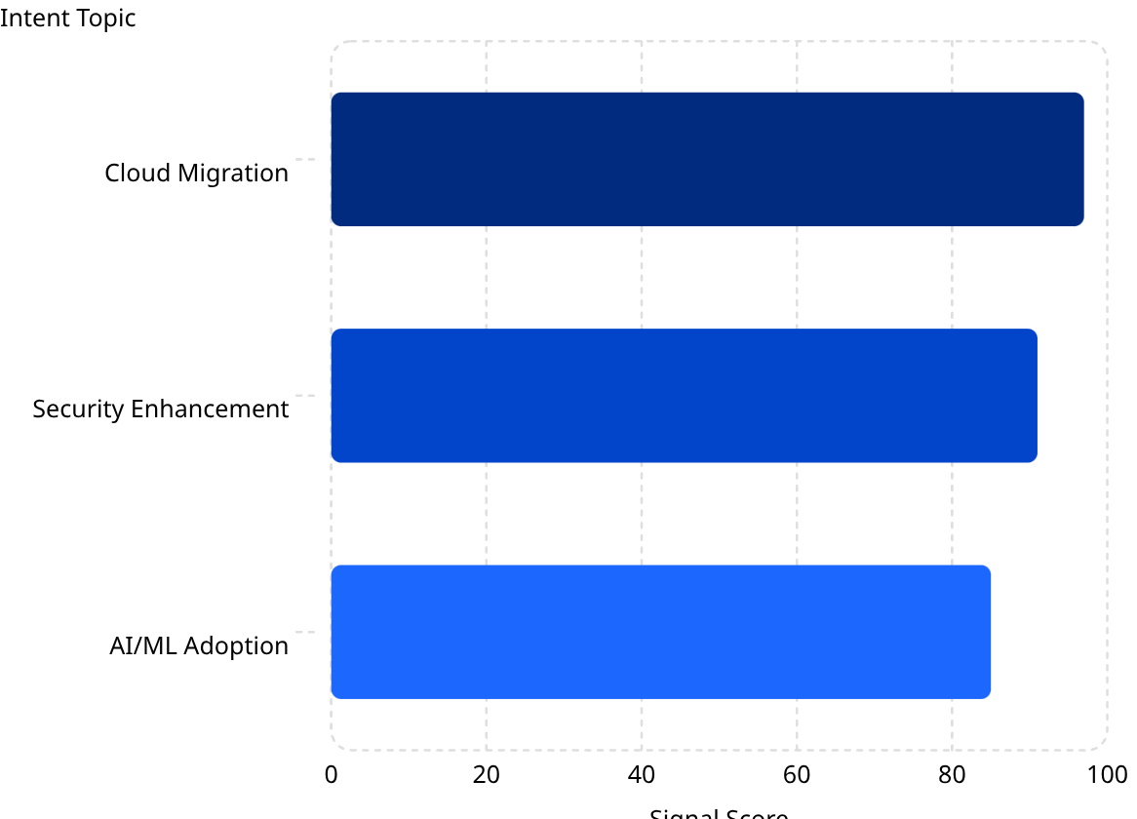

Buying Signals
Top 3 Intent Topics
01 – [Cloud Migration]
02 – [Security Enhancement]
03 – [AI/ML Adoption]
[Active evaluation of cloud migration strategies and infrastructure modernization.]
[Heightened interest in endpoint and cybersecurity posture improvements.]
[Emerging focus on artificial intelligence and machine learning capabilities.]
Signal Score Breakdown
[The bar chart illustrates the strength of Aviva Canada's intent signals over the past month for their top 3 topics. "Cloud Migration" shows the highest interest at 97, closely followed by "Security Enhancement" at 91 and "AI/ML Adoption" at 85. These scores indicate active evaluation in these areas.
*Signal Score indicates how big the spike is compared to a company's historical baseline for consuming content]
[Aviva Canada showed intent-signal activity in three areas: 1) Cloud Migration, 2) Security Enhancement, 3) AI/ML Adoption.]
Top partner mentions
[Competitive landscape includes Intact Financial Corporation, TD Insurance, The Co-operators, Wawanesa Mutual Insurance, Definity Financial (Economical Insurance), Allstate Insurance Canada.]

Slide 4

Key Signals
News & Triggers
1. [No Recent Funding, Expansion, or Partnership News Found]
2. [Active Intent Signals Across Cloud Migration, Security and AI/ML]
[Public news activity appears quiet, with no major announcements indicating immediate investment, expansion, or partnership-driven change.]
What this means: [The absence of recent funding announcements, expansion news, or strategic partnership activity suggests a period of operational stability at Aviva Canada. This is an opportunity to position HP as a proactive partner introducing future-ready solutions before a formal initiative is triggered, building trust and familiarity ahead of the next investment cycle.]
[Aviva Canada is showing active interest in modernization topics, including cloud migration, security enhancement, and AI/ML adoption.]
What this means: [Despite no public announcements, Aviva Canada is actively consuming content related to cloud migration, security enhancement, and AI/ML adoption. This signals internal evaluation activity likely tied to modernization planning. HP is well-positioned to enter the conversation with relevant content and solutions that align with these exact themes.]

Slide 5

Opportunity Themes
Pain points
Recommended solution areas
[Need for Enhanced Cybersecurity Measures]
[Aviva Canada faces increasing threats from cyberattacks, necessitating robust security solutions to protect sensitive customer data. The company's commitment to compliance and customer trust makes this a critical area for improvement.]
[Challenges in Managing Diverse Insurance Products]
[With a wide range of insurance offerings, Aviva Canada requires efficient management systems to streamline operations and enhance service delivery. This complexity can lead to inefficiencies and customer dissatisfaction if not addressed.]
[Standardization and Lifecycle Management of Devices]
[The need for standardization across devices is crucial for operational efficiency. Aviva Canada must ensure that all employees have access to up-to-date technology to maintain productivity and competitiveness.]
[Enhancing Cybersecurity Posture]
[Engage with Aviva Canada to explore their current cybersecurity measures and identify gaps. Present HP's solutions that can enhance their security posture and ensure compliance with industry regulations.]
[Streamlining Operations through Modernization]
[Discuss how the HP workplace modernization solutions can help Aviva Canada manage its diverse insurance products more effectively. Focus on understanding their current processes and identifying areas for improvement.]
[Implementing Device Standardization]
[Explore Aviva Canada's current device management practices and propose HP's device standardization solutions. Highlight the benefits of improved efficiency and reduced costs through lifecycle management.]

Slide 6
Sales Opportunities
1. [Enhancing Cybersecurity Posture]
2. [Streamlining Operations through Modernization]
3. [Implementing Device Standardization]
[Engage with Aviva Canada to explore their current cybersecurity measures and identify gaps. Present HP's solutions that can enhance their security posture and ensure compliance with industry regulations.]
[Discuss how the HP workplace modernization solutions can help Aviva Canada manage its diverse insurance products more effectively. Focus on understanding their current processes and identifying areas for improvement.]
[Explore Aviva Canada's current device management practices and propose HP's device standardization solutions. Highlight the benefits of improved efficiency and reduced costs through lifecycle management.]

Slide 7

Stakeholder Map:
Role Profile Alignment
Key Contacts​​
The following stakeholder profiles identify the primary decision-makers and influencers at [Aviva Canada.]
Persona note: Where a contact's title doesn't have a dedicated persona pack, we assign one from the closest proxy persona. (e.g., CIO, CTO, CFO, COO, CISO, and CPO). We do this based on their primary decision drivers (finance, operations, or technology) to keep outreach consistent and seller-usable.

Slide 8
Stakeholder Map: Stakeholder Profile
Persona
About
[CTO]
[Lisa Leo is the Technical Chief and Underwriter at Aviva Canada, sitting within the Technology department. She leads the technical underwriting function, bridging underwriting expertise with technology to modernize how risks are assessed, priced, and managed across the business.]
Contact
[Lisa Leo]
Title: [Technical Chief & Underwriter]
Strategic priorities
Contact Details
Department: [Technology]
Start date: [July 2025]
Direct Phone: [(800) 387-4518]
Mobile Phone: [(647) 209-7349]
Email: [lisa_leo@avivacanada.com]
LinkedIn: [https://www.linkedin.com/in/lisa-leo/]
[Underwriting Technology Modernization – Advancing the technology stack supporting underwriters to enable faster, more consistent decision-making.
Data & Analytics Enablement – Leveraging data and predictive analytics to sharpen risk selection and pricing accuracy.
Digital Transformation – Driving automation and digital workflows to reduce manual effort and improve underwriter productivity.]
Conversation starters
[Engage Lisa by demonstrating how your solution bridges technology and underwriting outcomes.
Lead with concrete examples of automation, data enrichment, or analytics capabilities that translate into measurable improvements in underwriting speed, accuracy, or loss ratio.]
Communication preference
[Phone / Email / LinedIn]

Slide 9



Recommended Sales Program
Recommended Next Steps
1. [Build awareness and credibility]
2. [Frame business challenges]
Marketing collateral: [Future-proof your IT for anywhere work]
Why: [Introduce emerging trends and thought leadership to build awareness and credibility with Aviva Canada stakeholders.]
Marketing collateral: [HP Workforce Experience Platform: Windows 11 Readiness]
Why: [Highlight business challenges and frame HP's solutions as ways to address Aviva Canada's cybersecurity, operational, and device management needs.]
3. [Demonstrate proven outcomes]
4. Enable decision-making
Marketing collateral: [High-performance power from anywhere]
Why: [Reinforce proof points with case studies and demonstrate integration value relevant to insurance sector operations.]
Marketing collateral: [Maximize productivity with AI workstation laptops]
Why: [Emphasize ROI, deployment support, and the ease of scaling with HP solutions to make the path to scaling and deployment tangible for Aviva Canada.]
Supporting assets:
Email templates, LinkedIn outreach templates, and call scripts tailored to C-suite personas.​
Email
LinkedIn
Call script

Slide 10

Supporting Assets – [CTO]
Email Template
Sender: HP Sales
Subject A: Insights that matter to [Aviva Canada]
Subject B: Supporting [Aviva Canada on Cloud Migration]
Hi [Lisa],
I understand [Aviva Canada] is focused on [Cloud Migration] this year. I wanted to share something that might help advance that work.
We've seen similar organizations strengthen endpoint security posture through targeted endpoint security enhancements.
I thought you might find this useful:
[Maximize productivity with AI workstation laptops]
Would you be open to a brief conversation about how we could help you enhance your cybersecurity posture?
Best regards,
[Evan Perkins]
HP Canada

Slide 11

Supporting Assets – [CTO]
LinkedIn Outreach Template
Subject: Supporting [Aviva Canada on Cloud Migration]
Hi [Lisa],
[Cloud migration] seems to be a key focus across [Insurance]. We've seen similar organizations strengthen endpoint security posture through targeted endpoint security enhancements.
Here's a short resource that outlines how:
[Maximize productivity with AI workstation laptops]
Would you be open to a quick chat about what might work best for [Aviva Canada]?
Best,
[Evan Perkins]
HP Canada

Slide 12

Supporting Assets – [CTO]
Call Script
Step 1: Provide Context
Voicemail Script
Hi [Lisa,] this is [Evan Perkins] with HP Canada.
I'm calling about [Cloud Migration]. I work with [Insurance teams] on this. Do you have 30 seconds to see if this is relevant?
Hi [Lisa,] this is [Evan Perkins] from HP Canada.
I wanted to share a quick idea about [Cloud Migration], something we've seen help [Insurance teams] improve cybersecurity measures.
If it's something you're exploring, I'd be happy to send over a short resource or set up a quick chat.
You can reach me at [phone number].
Again, it’s [Evan Perkins] with HP Canada. Hope we can connect soon.
Step 2: Explain Offering
A lot of [Insurance teams] we work with are looking to address enhanced cybersecurity measures, whether that's strengthening endpoint security or managing diverse product environments more efficiently.
At HP, we've been helping them by positioning HP as a strategic partner in enhancing endpoint security posture. Emphasizing the importance of proactive protection is core to what we do.
It's a quick change that made a measurable difference in Enhancing Cybersecurity Posture.
Objection Handling
Objection: I'm not interested.
Totally understand. I'm not calling to sell anything. I just wanted to share a quick perspective we've seen make a difference for other teams in [Insurance]. Would you be open to looking at a short resource?
Objection: We're already working with another vendor.
That's great. A lot of teams we work with were in a similar position and just wanted to see if there were areas they could do things a bit more efficiently. Would it make sense to share a quick example?
Objection: Now's not a good time.
Of course. Is there a time when you will be available later this week? I can make it quick. 10 minutes tops.
Objection: Send me something.
Absolutely. I'll send over a short piece on Cloud Migration. If it seems relevant, we can reconnect to see if there's a fit.
Step 3: CTA
I can send over a short resource that outlines how we approached this with other Insurance teams. Would that be useful?

Slide 13

Feedback and Questions
Let us know what you think.
Your feedback helps us make future reports even more relevant and useful.
Share your thoughts.
If you have any questions about this report, contact the HP Account Intelligence Desk at hpdesksupport@campaignhubs.com.

